Slide 1



Disclaimer:
I may not know everything!!!
Git & GitHub - 101
-By Richard McCormack-

Slide 2
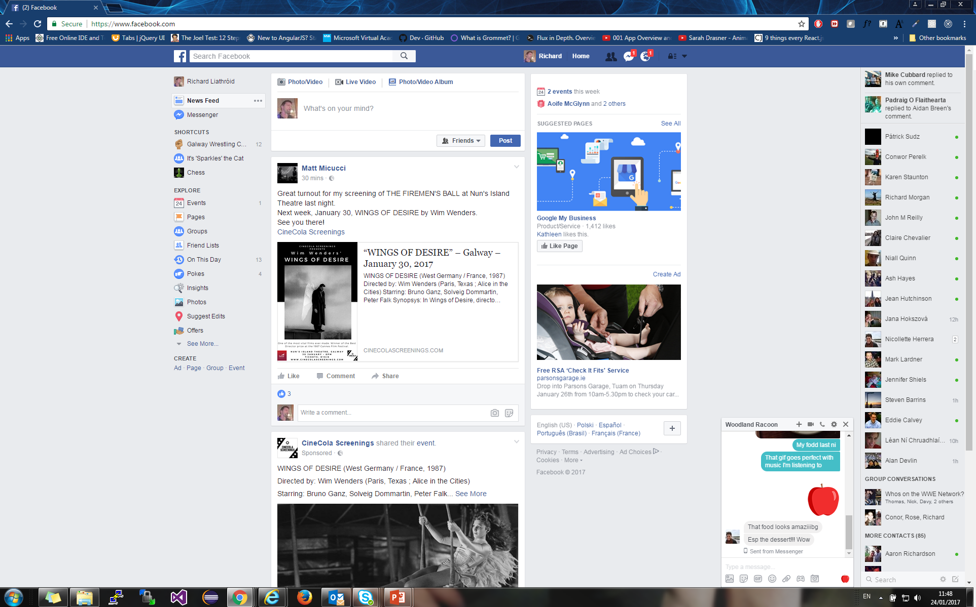








What is Version Control?
-Centralised vs Distributed Repository-
But it had it’s limitations, so the Linux Gods intervened…
Centralised Repository
-(SubVersion, etc.)
Once upon a time there was Centralised VC….
2. Distrubuted Repository
-(Git)

Slide 3

Local Flow of a Git Repo
-A basic Git Project Walkthrough-
*
Create Files
$: git add ___
$: git init
$: git commit –m “___”
Edit Files
$: git add .
$: git clone origin …
3. Changes Confirmed
Create Folders
$: git add --all
1. Repo Edited
2. Changes Stored

Slide 4
Git Directory Structure
-.git folder, .gitignore, and commit pointers-
[GENERAL WORKSPACE]
*
BRANCHHEADS
REMOTE INFO
COMMITS
LOCAL HOOKS
$: git init
-&-
.gitignore
.git
Note: Git config settings for user name, password, ssh keys, default message editor, and more are also stored here: this can be looked up online

Slide 5
Commits
COMMITS
-The basis of everything in Git Repository -
The origin/master will be covered later
Pointers
Repo’s Commits
Contents of a Commit
i. Only Stores the Modified Files (Differences) in the Commit;
ii. Pointers for Unchanged Files (Cookie-trail to last edit of each)
iii. Stores Hash Reference to Parent
HEAD
master HEAD
d0f3637bbcfb403f7ecf6ef48dd5009480df94
branch_1 HEAD
5267567982c03784cd4ceb60de6ff111992d28
ec5471974eca69f3b48b3421907c48fe10b241
825dc642cb6eb9a060e54bf8d69288fbee4904
origin/master
c8d3a7bff15578a94d7a43021fa3bea7127bdc
$: git commit –m “___”
7326de7d2f04cbcd8c6b0379d8d04474d31b62
Message Should be Short, Clear, and Summarise ALL edits made;
Message should be written in present tense;
Removing the ‘-m’ flag will cause the default editor to open
c38d70e51ea35cb5bb6854ed82c69f852acbb1
383e17082691d7b0412500ee0e0202811900d1
fbae3f93aaced523efa8b7816e85c102fcacf6

Slide 6
Branches
BRANCHHEADS
-Pointers for Commit & Workflow Maintenance-
HEAD
branch_1
master
master
HEAD
$: git checkout branch_1
$: git branch branch_1
branch_1
Repo Edited
$: git commit –a –m “__”

Slide 7
Remote Repositories
REMOTE INFO
-One Repo: Many Copies-
Bill Repo Pointers
Remote
Local Br.
master
$: git pull origin ___
branch_1
Ref to Remote
$: git push origin ___
origin/master
origin/branch_1
Bill’s PC
Dave Repo Pointers
Origin (Default Name)
master
branch_1
origin/master
Ref to Remote
origin/branch_1
origin/master
Everyone gets a copy… Remote is same logic and structure as local, but with some better joining features… GitHub is just one such
origin/branch_1
Dave’s PC

Slide 8
DANGER!!!!
-Live Demonstration: init, .gitignore, add, commit, branch, checkout, remotes (add, push, pull)-
Notes:
Create 2 branches and have a remote pre-setup, adding a .gitignore, showing with git status

Slide 9
Hooks (Local & Remote)
LOCAL HOOKS
-A way to sanitise Commits & Remote Pushes before or after they are transmitted-
1. Local Example
-if ( <local Unit Tests> == Pass){
<Allow Push Completion>
}
2. WebHook (Remote) Example
-if ( <Jenkins Build On Test CI> == Pass){
<Update Master Branch>
}
Origin Repo > Settings > Webhooks > New > Type
cp ./branches/ example
Bill’s PC
Origin

Slide 10
Advanced Branches
-Merges, Fast Forwards & Rebases-
Last Release Commit [7634rD]
Feature 1 Merge Commit [67395R]
master
Branch_1 First Commit
[08xkj1]
HEAD
?
branch_1
Contents
-File001.txt;
-File002.txt;
-File003.js
Contents
-Unchanged File001.txt;
-Deletes File002.txt;
- Changed Default Names to ‘Unknown’ File003.js
Contents
-Unchanged File001.txt;
-Unchanged File002.txt;
-Changed Default Names to ‘Default’ File003.js

Slide 11
DANGER!!!!
-Live Demonstration: Clone, Merge with Conflict-
Notes:
Open new file locn, pull, clone. Do a commit on both branches, resolve, & push

Slide 12
Workflow / Branching Strategies
-A basis -
Came From
Release 1.0
feat.
dev
test
master
master
Fast Forward
Rebase
Release 1.0
CI Build
Testhere…
test
Branch Rewrite
Rebase
dev
Feature 1
Feature 2
Feature 3

Slide 13

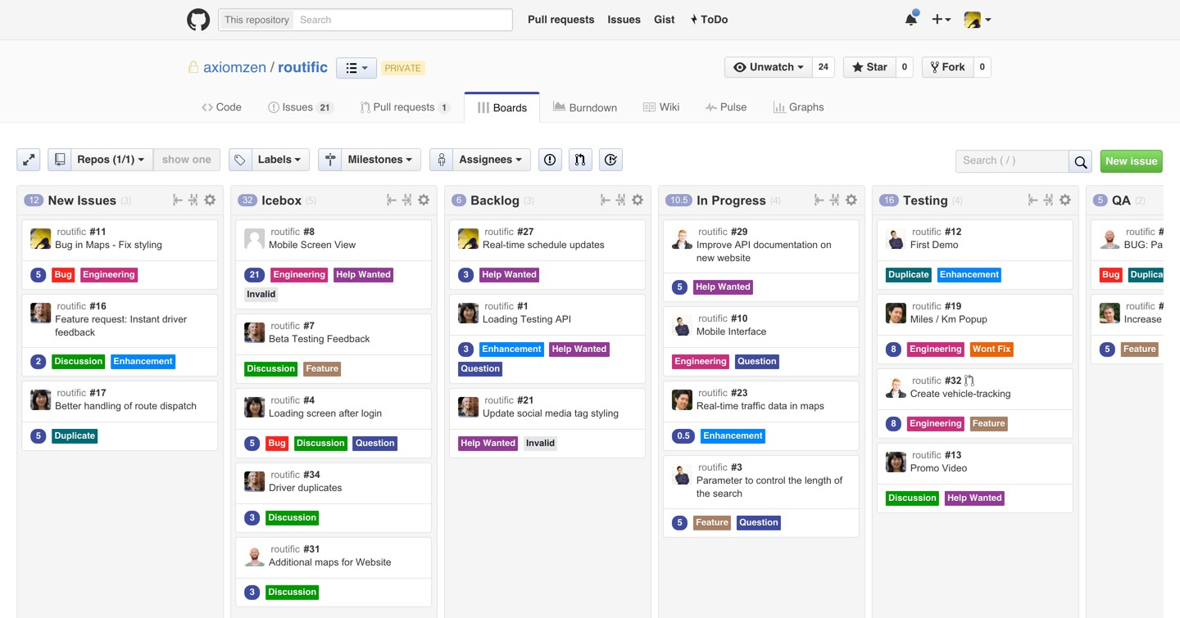

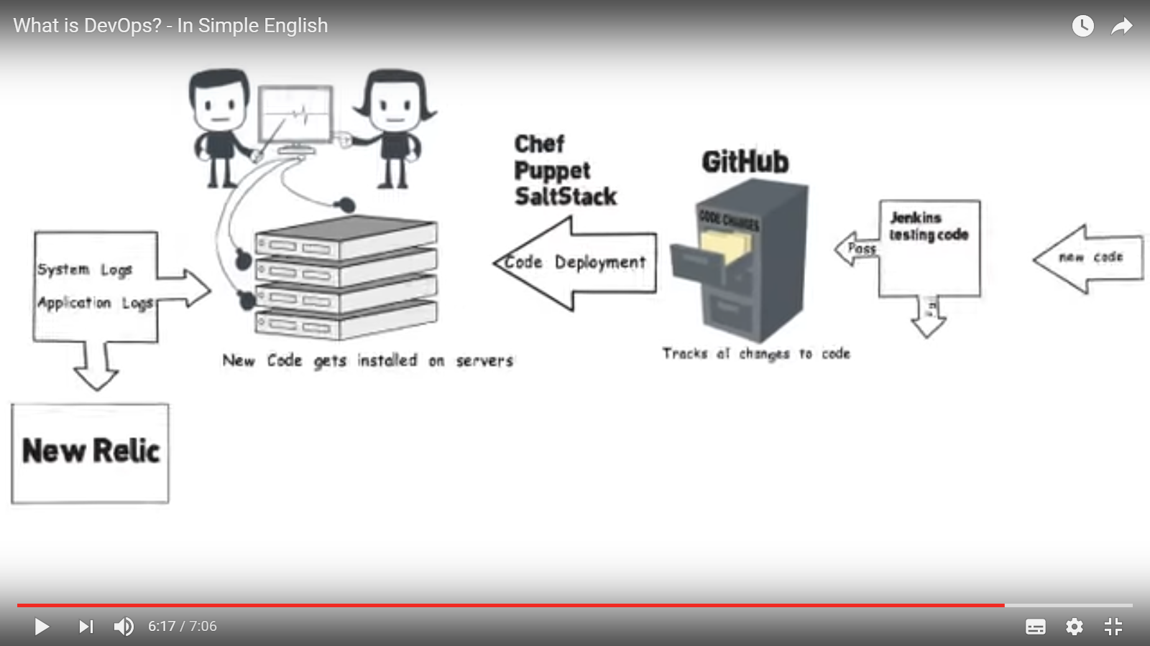
How Git Fits Into DevOps
-Git Integrations, & GitHub as Project Mgmt Tool-
WebHooks
https://iniy.org/wp-content/uploads/2016/05/board.jpg
Local & Web Hooks, with GitHub Features Board
https://www.youtube.com/watch?v=_I94-tJlovg
Local & Web Hooks, with and without Jenkins
WebHooks
To name but a few…

Slide 14




Thank You!
Questions & Answers ???

Slide 15
So where to now?
-Links to Useful Learning Resources-
Git Docs: https://git-scm.com/documentation
Intro Course: https://www.udacity.com/course/how-to-use-git-and-github--ud775
Another Course: https://www.youtube.com/watch?v=r63f51ce84A&list=PLGLfVvz_LVvQHO1PfyscjIPkNJjgHsLyH
Try Basics Online: https://try.github.io/levels/1/challenges/1
Try More Online: http://learngitbranching.js.org/
Online Books available on Safari also!!!!

